Slide 1
The NeQuick source code
Yenca Migoya-Orue’ – T/ICT4D – ICTP
Workshop on SW and Upper Atmosphere Physics, Kathmandu - Nepal 23 – 27, September 2019

Slide 2
Overview
1
2
NeQuick 2 main functions and subroutines
3
Guide to different uses of NeQuick
General model code description
4
Guide to compiling and running
Package content

Slide 3
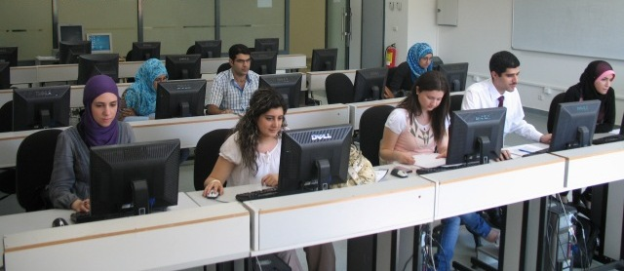
Learning Objectives
Familiarize yourself with the model
Know how to compile and run NeQuick
Write a simple driver program
Notes:
What will the audience be able to do after this training is complete? Briefly describe each objective how the audience will benefit from this presentation.

Slide 4
NeQuick 2: 1. General model code description
NeQuick's profile formulation includes 6 semi-Epstein layers with modelled thickness parameters and it is based on anchor points defined by foE, foF1, foF2 and M(3000)F2 values.
Topside
These values can be modelled (e.g. ITU-R coefficients for foF2, M(3000)F2) or experimentally derived.
h [km]
Bottomside
Anchor points
Ne [m-3]
Position (degN,degE,km)
Time (mth, UT)
Solar Activity (R12,F10.7)
Ne (φ,λ,t)
TEC
Notes:
NeQuick is a "profiler" which makes use of three profile anchor points:
E layer peak (at a fixed height of 120 km), F1 peak, F2 peak.To model the anchor points it uses the "ionosonde parameters” foE, foF1, foF2 (critical frequencies) and M3000(F2) (transfer parameter). For foE it uses a model by John Titheridge; foF1 is taken to be proportional to foE during daytime (foF1=1.4*foE) and 0 during nighttime. For foF2 and M3000(F2) it uses the ITU-R (CCIR) coefficients in the same way used by the (IRI).

Slide 5
NeQuick 2 : 1. Package content
Content of NeQuick 2 package
NeQuick_2_0_2.for
slQu_2_0_2.for
ccir11.asc…ccir22.asc
modip.asc
R12.dat
/Test cases
README.txt
FORTRAN 77 source code
ITU-R coefficients
Grid of modip values
R12 values from 1931 to 2015

Slide 6
NeQuick 2 : 1. Package content
ITU-R (CCIR) files
NeQuick 2 uses the ITU-R coefficients to compute foF2 and M(3000)F2 characteristics. These coefficients are stored in the ccirXX.asc files and include the spherical harmonic coefficients representing the development of monthly median foF2 and M(3000)F2 all over the world. The coefficients correspond to low (SSN=0) and high (SSN=100) solar activity conditions and must be interpolated (or extrapolated) to obtain the values for the solar activity required.
Note: Since NeQuick 2 is compliant with ITU-R Recommendation P.1239 does not accept
(by default) F10.7 input values below 63 F.U. (R12=0) and saturates the F10.7 at 193 F.U
(R12=150) if solar flux input exceeds 193 F.U (R12=150).

Slide 7
NeQuick 2 : 1. Package content
Modip file
NeQuick 2 model uses a grid of modip, μ values contained in the file modip.asc. The values of modip are expressed in degrees and are organized from 90 S to 90N of latitude in steps of 5 degrees and from 180W to 180E of longitude in steps of 10 degrees.
To compute the modip value in a point at latitude φ and longitude λ , a third order interpolation is applied.
Note: The modip map included in the package of NeQuick2 corresponds to the geomagnetic field given by the IGRF model for the year 2005.
In the case you want to update or use a different geomagnetic field model you can replace the modip.asc file taking into account the grid spacing (5 degrees of lat x 10 degrees of long)
Rawer [1963]

Slide 8
2.NeQuick 2 main functions
and subroutines

Slide 9
NeQuick 2 : 2. Main functions and subroutines
NeQuick2_0_2.for
All the necessary functions and subroutines to compute Ne.
Model parameters functions.
slQu2_0_2.for
Main program
Calculate TEC for arbitrarily chosen rays which do not cut the surface of the Earth between the given endpoints.
Auxiliary parameters computation.
Auxiliary subroutines and functions
Slqu.dat

Slide 10
NeQuick 2 : 2. Main functions and subroutines
NeQuick_2_0_2.for
function NeQuick(h,alat,along,mth,flx,UT) → Ne [m-3]
subroutine prepNeQ(alat,along,mth,UT,flx) → hm,Nm,thickness parameters
Ne Computation:
function NeNeQ(h,hm,aep,bb) → Ne [m-3]
function NeMdGR(aep,hm,bb,h) → Ne [m-3], h<=hmF2
function topq(h,No,hmax,Ho) → Ne [m-3], h>hmF2
subroutine prepmdgr(mth,R12,foF2,efoF1,efoE,M3000)→ hm,Nm,thickness param.

Slide 11
NeQuick 2 : 2. Main functions and subroutines
NeQuick_2_0_2.for
Cont.d
subroutine ef1(alat,mth,flx,chi,foF2) → efoE[MHz],efoF1[MHz]
subroutine cciri(xMODIP,mth,UT,R12,alat,along) → foF2[MHz],M3000
function gamma1(xMODIP,alat,along,hour,iharm,nq,k1,m,mm,m3,sfe)
function peakh(foE,foF2,M3000) → hmF2[km]
subroutine sdec(mth,UT,sdelta,cdelta)
subroutine modin(pmodip)
function amodip(pmodip,alat,along) -> modip

Slide 12
NeQuick 2 : 2. Main functions and subroutines
slQu_2_0_2.for
TEC Calculation
ray conventions:
spherical Earth (RE=6371,2km)
straight line "rays“
coordinate s [km] along the ray, origin in ray perigee, point of ray closest to the centre of the Earth.
function gint → numerical integration along a slant ray
function gintv → numerical integration along a vertical ray
(if rp<0.1km)

Slide 13
NeQuick 2 : 2. Main functions and subroutines
slQu_2_0_2.for
Cont.d
subroutine rays → set and check ray endpoints,
calculates geometric parameters for ray
subroutine dat_t_sa → set date and solar activity
subroutine gcirc → calculates great circle path properties
subroutine naut → calculates position of ray perigee, zenith angle of ray at lower endpoint, and slant to vertical projection factor cos(chi)
subroutine geogra → calculates h, lat and long along the ray from the perigee of the ray, s
function eld → gives Ne as a function of the coordinate s

Slide 14
3. Different uses of NeQuick

Slide 15
NeQuick 2 : 3. Different Uses of NeQuick
For compliancy reasons, the NeQuick 2 code does not allow a F10.7
input below 63 F.U. (R12=0) and saturates the F10.7 at 193 F.U (R12=150)
if solar flux input exceeds 193 F.U (R12=150).
In the case the NeQuick functions and subroutines are called in another
programs, if a F10.7 (or R12) value exceeds the upper limits of 193 F.U.
(R12=150), the subroutine will saturate F10.7 at 193 F.U. (R12 at 150).
If a value below 63 F.U (R12=0) is input, the subroutine will stop the program.
The limits on F10.7 (or R12) input can be removed at the user’s own risk by
commenting the lines 197 to 208 in the source file NeQuick_2_1.for
(prepNeq subroutine) as follows:

Slide 16
NeQuick 2 : 3. Different Uses of NeQuick
195C *** flux saturation above 193 FU and blocked below 63 FU to avoid
196C unrealistic or undefined electron density values! ***
197 if (flx1 .gt. 193.0D0) then
198 flx1=193.0D0
199 write(*,'(2A/A/A)')'***WARNING! Solar flux limit F=193 (R12=150)',
200 & ' exceeded.',
201 & ' NeQuick saturates F to 193 units',
202 & ' (ITU-R P.1239 reccomendation).'
203 endif
204 if (flx1 .lt. 63.0D0) then
205 write(*,'(2A/A)')'***WARNING! Solar flux below 63 FU (R12 <0)',
206 & 'program stopped!'
207 stop
208 endif
195C *** flux saturation above 193 FU and blocked below 63 FU to avoid
196C unrealistic or undefined electron density values! ***
197C if (flx1 .gt. 193.0D0) then
198C flx1=193.0D0
199C write(*,'(2A/A/A)')'***WARNING! Solar flux limit F=193 (R12=150)',
200C & ' exceeded.',
201C & ' NeQuick saturates F to 193 units',
202C & ' (ITU-R P.1239 reccomendation).'
203C endif
204C if (flx1 .lt. 63.0D0) then
205C write(*,'(2A/A)')'***WARNING! Solar flux below 63 FU (R12 <0)',
206C & 'program stopped!'
207C stop
208C endif
WARNING!
After removing the limits on F10.7 (or R12), if values outside the range [63,193] for F10.7
(or [0,150] for R12) are used, unrealistic or undefined electron densities values can be obtained.

Slide 17
NeQuick 2 : 3. Different Uses of NeQuick
Topside
These values can be modelled (e.g. ITU-R coefficients for foF2, M(3000)F2) or experimentally derived.
Bottomside
Anchor points
Ne [m-3]
In NeQuick_2_0_2.for:
call cciri(xMODIP,mth0,UT0,R12,alat,along,foF2,M3000)
231 call ef1r(alat,mth1,flx1,chi,foF2, efoE,efoF1)

Slide 18
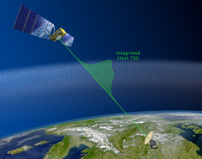
4.NeQuick usage: compiling and running

Slide 19
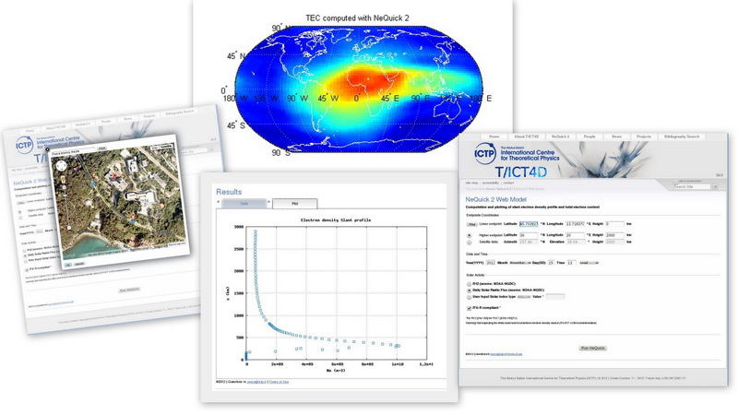
New to NeQuick?
START HERE!

Slide 20
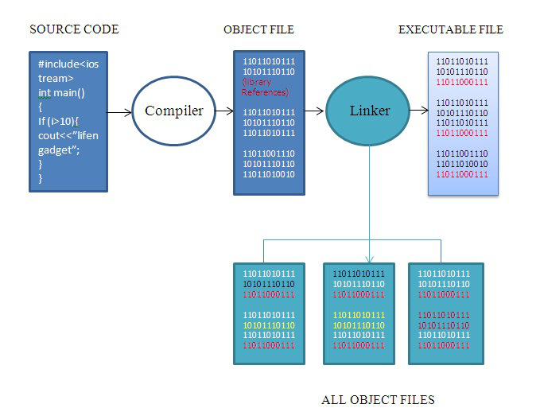
NeQuick 2 : 4. Compiling and running

Slide 21
Text Editor
NeQuick_2.for
slQu_2.for
Source Code
Translate
compiler
Object Code
NeQuick_2.o
slQu_2.o
linker
Put together
Executable Code
Neq.exe, a.out, etc

Slide 22
NeQuick 2 : 4. Compiling and running
Fortran 77 compilers
F77
G77
Intel Fortran Compiler for Linux
Gfortran – the GNU Fortran Compiler
Salford FTN95 Compiler
For Windows Users:
MinGW 's (Gfortran, G77)
Cygwin
Force Project

Slide 23
NeQuick 2 : 4. Compiling and running
NeQuick Compilation
Compile and Link NeQuick_2.for and slQu_2.for with a FORTRAN 77 compiler
Command format:
compiler [-o outputfile] NeQuick_2.for slQu_2.for
For example:
f77 –o neq2 NeQuick_2.for slQu_2.for
To run:
./neq2
./a.out
a.exe

Slide 24
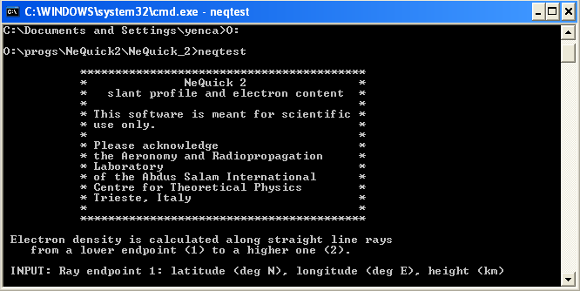
NeQuick 2 : 4. Compiling and running
Running…

Slide 25
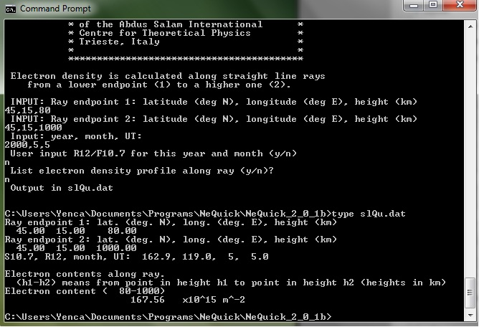
NeQuick 2 : 4. Compiling and running
Running…
Not TECU!

Slide 26
Questions?

Slide 27
To be continued…

Slide 28
Laboratory Session
Yenca Migoya-Orue’ – T/ICT4D – ICTP
Workshop and Conference on NeQuick Latest Developments and Advanced Uses – ICTP 4-8 May 2015

Slide 29
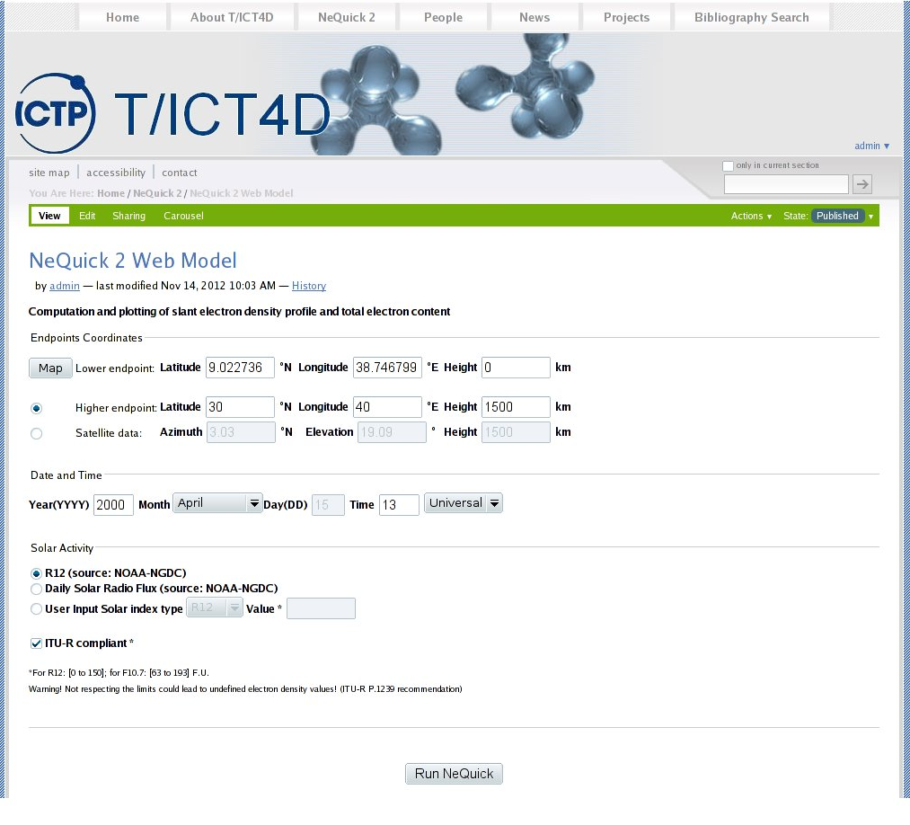
NeQuick 2 : Laboratory Session
T/ICT4D web site
http://t-ict4d.ictp.it/nequick2

Slide 30
NeQuick 2 : Laboratory Session
From a linux terminal type:
wget http://users.ictp.it/~yenca/NeQuick_workshop/NeQuick2_0_2.zip
unzip NeQuick2_0_2.zip
cd NeQuick2_0_2
ls

Slide 31
NeQuick 2 : Laboratory Session
NeQuick Compilation
Compile and Link NeQuick_2.for and slQu_2.for with a FORTRAN 77 compiler
Command format:
compiler [-o outputfile] NeQuick_2.for slQu_2.for
For example:
gfortran NeQuick_2.for slQu_2.for
To run:
./a.out

Slide 32
NeQuick 2 : Laboratory Session
Plot the output
For vertical profiles:
gnuplot -p -e “set yrange[0:2000]; plot 'slQu.dat' every::12 u 5:2 w lp”
For slant profiles:
gnuplot -p -e “set yrange[0:2000]; plot 'slQu.dat' every::15 u 6:3 w lp”

Slide 33
NeQuick 2 : Laboratory Session
Exercise
I have VTEC derived from a GNSS station and I want to calculate VTEC
with NeQuick for a specific month and year along the day every hour.
real*8 function vtec(h0,h2,alat, along, mth, ut, az)
implicit real*8 (a-h,o-z)
dimension hm(3),aep(3),bb(6)
real*8 gintv
common /nepar/hm,aep,bb
h1a=1000.0D0
h1b=2000.0D0
call prepNeQ(alat,along,mth,ut,az,hm,aep,bb)
tec1=gintv(h0, h1a,1.0D-3)
tec2=gintv(h1a,h1b,1.0D-2)
tec3=gintv(h1b,h2, 1.0D-2)
tec4=tec1+tec2+tec3
vtec=tec4/1.0D13
return
end

Slide 34
real*8 function gintv (g1,g2,eps)
C integrates NeNeQ for vertical profile
implicit real*8 (a-h,o-z)
real*8 NeNeQ
dimension hm(3),aep(3),bb(6)
common /nepar/hm,aep,bb
gint1 = 0.0D0
n = 8
1 h = (g2-g1) / dfloat(n)
hh = 0.5D0*h
g = h*0.5773502691896D0
y = g1 + (h-g)*0.5D0
gint2 = NeNeQ(y,hm,aep,bb)+
+ NeNeQ(y+g,hm,aep,bb)
do m = 1,n-1
gint2 = gint2 + NeNeQ(y+h+g,hm,aep,bb)+
+ NeNeQ(y+h,hm,aep,bb)
y = y + h
enddo
gint2 = gint2*hh
if (n.eq.8.or.abs(gint1-gint2).gt.eps*abs(gint1)) then
n = n*2
gint1 = gint2
if (n.lt.1024) goto 1
endif
gintv = gint2+(gint2-gint1)/15.0D0
return
end

Slide 35
Driver Program Example
program NeQ_Station
implicit none
real*8 ut,stat_lat,stat_lon,h0,h2,flx,tec
integer mth,year,h
character*30 filename
C Invoked function
double precision vtec
h0=0.0
h2=20000.0
year=
mth=
flx=
stat_lat=
stat_lon=
filename='filewithTEC.txt'
open(16,file=filename)
do h=0,23
ut=real(h)
tec=vtec(h0,h2,stat_lat,stat_lon,mth,ut,flx)
write(16,'(2F8.2)')ut,tec
enddo
close(16)
end program NeQ_Station

Slide 36
NeQuick 2 : Laboratory Session
Command format:
gfortran [-o outputfile] NeQuick_2_0_2.for NeQ_Station.f vtec.f gintv.f

Slide 37
Laboratory Assignment

Slide 38
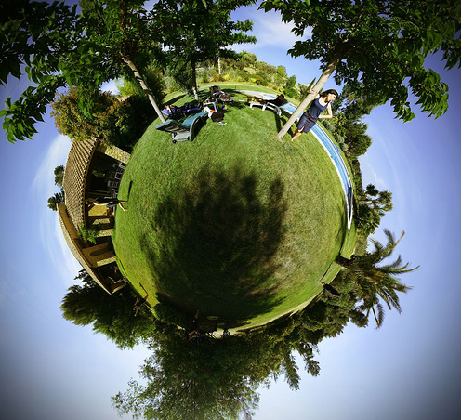
NeQuick 2 : Laboratory Session
How does the NeQuick model represent the ionosphere over Nepal?

Slide 39
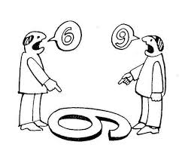
NeQuick 2 : Laboratory Session
EXERCISE DESCRIPTION (1)
Get TEC from a GNSS station on Nepal every 1hour and for at least 3 days.
Goπ!
Gg!

Slide 40
NeQuick 2 : Laboratory Session
EXERCISE DESCRIPTION (2)
Run the NeQuick 2 (in climatologic default mode) to compute the TEC for the same epoch of your TEC of reference and compare the results.
TIPS
Better use quiet periods ;)
You can compare VTEC or STEC
Other models, data and also profiles can be added to the exercise.
Feel free to use the tools of your preference.

Slide 41
Resources
T/ICT4D website:
NeQuick2: http://t-ict4d.ictp.it/nequick2/nequick-2-web-model
TEC: http://t-ict4d.ictp.it/nequick2/gps-tec-calibration-online
IRI website:
http://omniweb.gsfc.nasa.gov/vitmo/iri2012_vitmo.html
MingW:
http://www.mingw.org/
Daily F10.7:
ftp://ftp.swpc.noaa.gov/pub/indices/quar_DSD.txt
ftp://ftp.ngdc.noaa.gov/STP/space-weather/solar-data/solar-features/solar-radio/noontime-flux/penticton/penticton_observed/listings/listing_drao_noontime-flux-observed_daily.txt
Ionosonde characteristics and ionograms:
http://giro.uml.edu/didbase/scaled.php
http://ulcar.uml.edu/DIDBase/

Slide 42
Questions?

Slide 43
Thanks for your attention!
(again)

